Slide 1
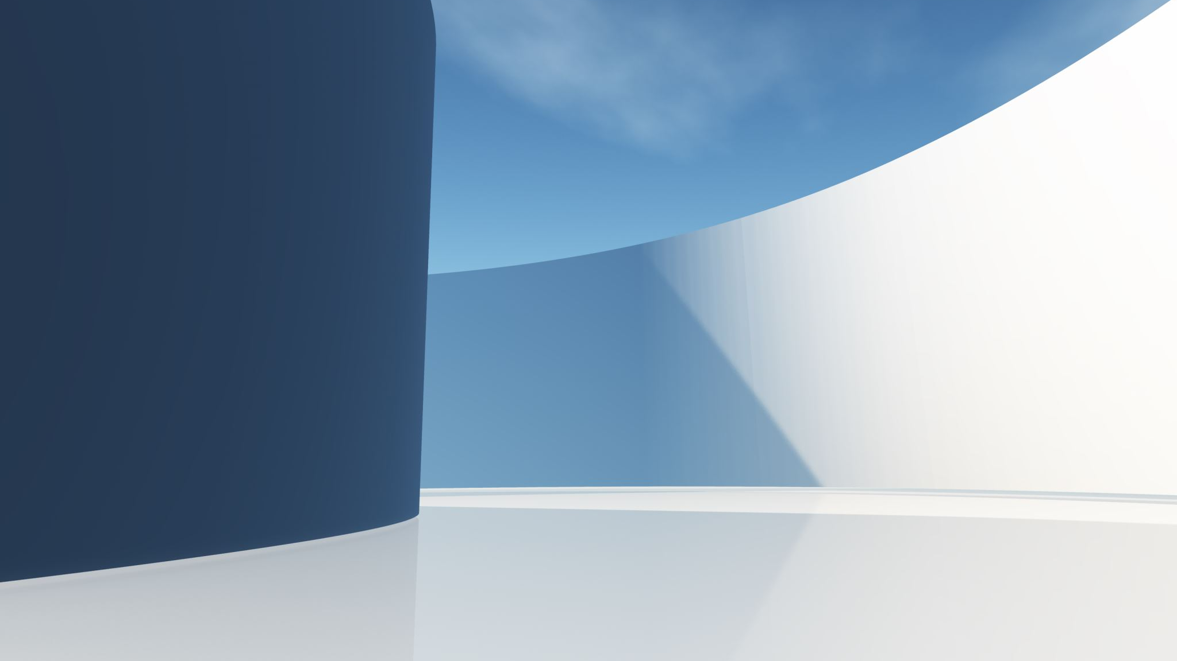
Experimental Analysis Of Pixel Based Brain Tumor Detection on BraTS 2020 Dataset
Varsha Annamalai
Dept. Of computer sciences
University of north Carolina Greensboro
V_annamalai@uncg.edu
Advisor: shan suthaharan

Slide 2
Content
Problem statement
Project Scope
Introduction
Dataset
Methodology
Experimental Section
Result Section
Observation
Conclusion
Notes:
Today I'm going to start with the problem statement and what inspired this project.
Followed by a brief introduction on what this project is all about
I am going to then talk a little bit about the dataset.
And the methodology that I have used in this project followed by the experimental study used and the result section.
Finally ill be talking about the observations done in this project and conclusion.
We will have enough time for Q&A at the end of the presentation but feel free to stop me at any point during the presentation if you have any questions or need any clarifications.
So, Before going into the problem statement , I would like to talk about a few non-technical facts and information about the project.
Medical Imaging
FACT
November 8, 1895 – marked (as a big milestone in medical history) the beginning of the field of medical imaging (according to "National Institutes of health.gov (NIH)")
When Wilhelm Conrad Röntgen discovered the X-ray, while experimenting with cathode rays, and the first X-ray image was taken of his wife's hand.
Since then Medical Imaging has been playing an important role, in creating images of the human body for the healthcare professionals to diagnose, monitor and treat medical conditions by providing a detailed view of the internal structure of the body.
MRI
Images of the human body are created using a variety of means such as ultrasound, magnetic resonance, nuclear medicine and X-rays.
The one we are using is Magnetic resonance imaging (MRI),
FACT
Another fact, July 3, 1977 was when the first MRI exam was done on a live human patient. (according to "American Physical society.org")
And since then it has become an extremely useful non-invasive method for imagining internal bodily structures and diagnosing disease.

Slide 3
Problem Statement
MRI-based brain tumor detection are prone to errors due to the inherent limitations of human interpretation. Further, tumors differ significantly in type, size, shape, and location, leading to a high potential for smaller tumors to be missed. This complicates the accurate diagnosis and treatment of brain tumors and hence poses a significant risk to patient health.
Project Scope
This project focuses on enhancing the accuracy and reliability of MRI-based brain tumor detection by exploring multiple medical image analysis techniques. The approach followed include:
Creating feature spaces with various feature combinations.
Applying image processing techniques, such as filters.
Implementing pixel-based detection methods.
Notes:
Challenge – However MRI-based brain tumor detection remains a critical challenge.
Due to the varying type, size, shape, and location of tumor for every patient.
Variability in tumor appearances depending the type and location.
The potential for small tumor to be missed.
The presence of normal tissue mimicking tumors.
Factors like patient movement during scans Etc.
Solution – To focus on addressing these challenge, we explored different medical imaging analysis techniques in combination.
feature space creation with different features combinations (8 features, 10 features), which were selected with the help of feature importance matrices to prioritize the most relevant attributes.
image processing techniques (filters)
Pixel based detection technique

Slide 4
Introduction
Image Processing Techniques are uses to modify image’s properties by altering the values of pixels based on the values of neighboring pixels to prepare them for further analysis. These techniques involve applying various filters, noise reduction, edge detection, feature extraction, and segmentation which helps while feature space creation and better training.
Feature Space Creation is construction of multi-dimensional and detailed representations of image characteristics, which makes it useful for visualizing and analyzing datapoints and easier with creating pixel-based brain tumor detection models that are more reliable and accurate.
Pixel Based Brain Tumor Detection is an analysis of MRI images at a granular level to identify and differentiate between tumor and non-tumor regions. Analyzing each pixel ensures that no details are missed for more accurate tumor detection
Random forest, a machine learning model trained to classify each pixel based on its pixel values that indicate the presence of a tumor. An algorithm making predictions based on a collection of decision tress.
Notes:
Image Processing Techniques
Modify image’s properties by altering the values of pixels based on the values of neighboring pixels to prepare them for further analysis.
Techniques involve - applying various filters, noise reduction, edge detection, feature extraction, and segmentation.
This process helps while feature space creating and bettering training.
Feature Space Creation
Construction of a multi-dimensional detailed representation of image char.
The dimension of the feature space is determined by the number of features used to describe the patterns. (we experimented with 8, 6, 14, and 10 features)
which makes it useful for visualizing and analyzing datapoints and easier with creating pixel-based brain tumor detection models that are more reliable and accurate.
Pixel Based Detection Technique
An analysis of MRI images at a granular level to identify and differentiate between tumor and non-tumor regions.
Analyzing each pixel ensures that no details are missed for more accurate tumor detection.
Machine Learning models (classifiers)
ML models are trained to classify each pixel based on its pixel values that indicate the presence of a tumor.
Random forest, machine learning model is used. It uses a collection of decision tress to make prediction.

Slide 5
Dataset – BraTS Dataset
This project is builds upon a previous version titled " Pixel Level Feature Space Modeling and Brain Tumor Detection using Machine Learning". Which used BraTS 2015 dataset and focused on single volumetric data.
While my project utilizes BraTS 2020 dataset from Kaggle, as it provides access to a more comprehensive, varied, and up-to-date dataset, which can lead to more robust and generalizable models for brain tumor detection and segmentation. The improved annotations, increased data quantity makes it a superior choice for contemporary research compared to BraTS 2015.
The data is extracted and is in NIfTI (Neuroimaging Informatics Technology Initiative) format (.nii.gz) as a volumetric data.
For this study, the first 20 volumetric data of different patient cases has been considered, enabling a more comprehensive analysis and evaluation.
Notes:
This project is builds upon a previous version titled "Pixel Level Feature Space Modeling and Brain Tumor Detection using Machine Learning" done by Ritu joshi. Which used BraTS 2015 dataset and focused on single volumetric data.
R. Joshi, S. Suthaharan, "Pixel-Level Feature Space Modeling and Brain Tumor Detection Using Machine Learning," ICMLA, pp. 0-6, 2020
While my project utilizes brain tumour segmentation dataset(BraTS) 2020 from Kaggle, as it provides access to a Larder dataset with more patient cases,
more comprehensive,
varied, and
up-to-date dataset,
Pre-processed,
more accurate and detailed segmentation labels,
which can lead to more robust and generalizable models
The improved annotations, increased data quantity makes it a superior choice for contemporary research compared to BraTS 2015.
NIfTI format - Which is nothing but neuroimaging informatics technology initiative, a volumetric data that provides a flexible, broad-based and common file format used in neuroimaging data to store and exchange medical image data, especially in MRI.
Volumetric data – Is a 3D image, with a collection of samples representing the value of a property at a specific location in 3D space. Made up of coordinates (x, y, z) and a value v (colour, density, pressure).
We also expanded and used 20 volumetric data samples for my project, enabling a more comprehensive analysis, robust and generalized evaluation.

Slide 6
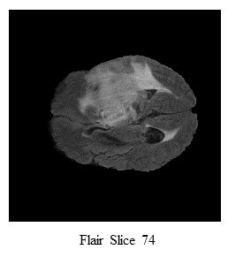
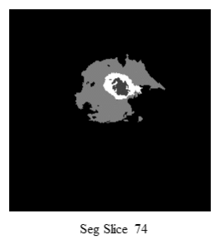
Dataset – MRI Modalities
The dataset contains 4 MRI modalities
T1-weighted (T1),
T1-weighted Contrast Enhanced (T1wCE)
T2-weighted (T2w)
T2-Fluid Attention Recovery (FLAIR).
We leverage the T2-Fluid Attention Recovery (FLAIR) and segmentation images containing the ground truth for the study.
Notes:
The benefit of having multiple alternative MRI modalities is its complementary information, since the brain tumor has multiple sub-regions - Whole tumor, Tumor core, Enhancing tumour.
T2weighted (T2w) and T2-Fluid Attention Recovery (FLAIR) - detect the tumor with the pre- temporal edema.
T1-weighted (T1) and T1weighted Contrast Enhanced (T1wCE) - detect the tumor core without pre- temporal Edema.
We have considered 20 volumetric data leveraging the T2-Fluid Attention Recovery (FLAIR) and segmentation images containing the ground truth.

Slide 7
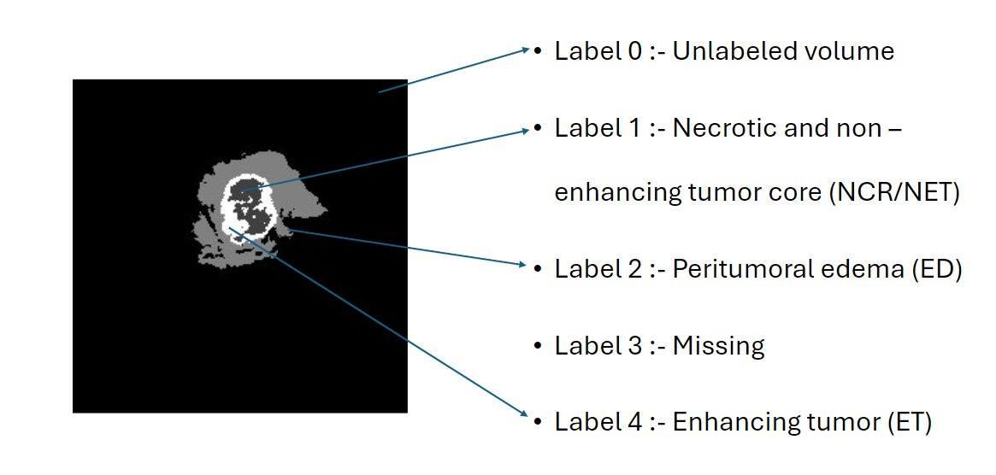
Dataset – Ground Truth
The segmentation files contain Ground truth which is meticulously annotated and verified information about the structures or features within an image.
The Ground truth (GT) provided in the BraTS dataset has 5 label :
Label 0 :- Unlabelled volume
Label 1 :- Necrotic and non-enhancing tumor core (NCR/NET)
Label 2 :- Peritumoral edema (ED)
Label 3 :- Missing
Label 4 :- Enhancing tumor (ET)
Notes:
The segmentation files contain Ground truth which is meticulously annotated and verified information about the structures or features within an image.
Mohammad A. Ottom, Hanif A. Rahman, Iyad M. Alazzam, Ivo D. Dinov “Multimodal Stereotactic Brain Tumor Segmentation Using 3D-Znet,” MDPI, Bioengineering 2023, 10, 581. https://doi.org/10.3390/bioengineering10050581
The Ground truth (GT) provided in the BraTS dataset has 5 label :
Label 0 :- Unlabeled volume
Label 1 :- Necrotic and non-enhancing tumor core (NCR/NET)
Label 2 :- Peritumoral edema (ED)
Label 3 :- Missing - (Multimodal Stereotactic Brain Tumor Segmentation Using 3D-Znet)
Label 4 :- Enhancing tumor (ET)

Slide 8
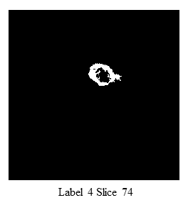
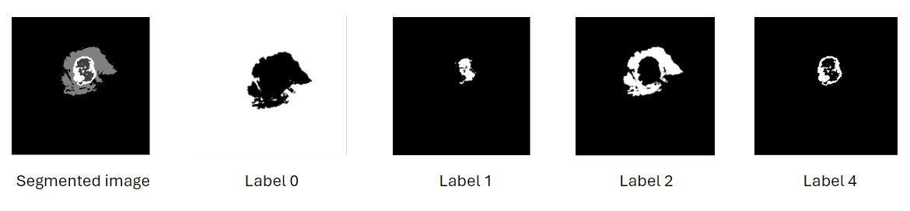
Dataset – Fourth Label
The fourth label, enhancing tumor (ET) representing tumor regions is extracted through binary masking approach which provides a clear delineation of tumor boundaries.
Notes:
We extract the 4th level which is enhancing tumour representing the tumour region with the help of binary masking.
Binary masking - segmentation technique, that involves isolating and highlighting the region of interest which is associated with tumors.

Slide 9
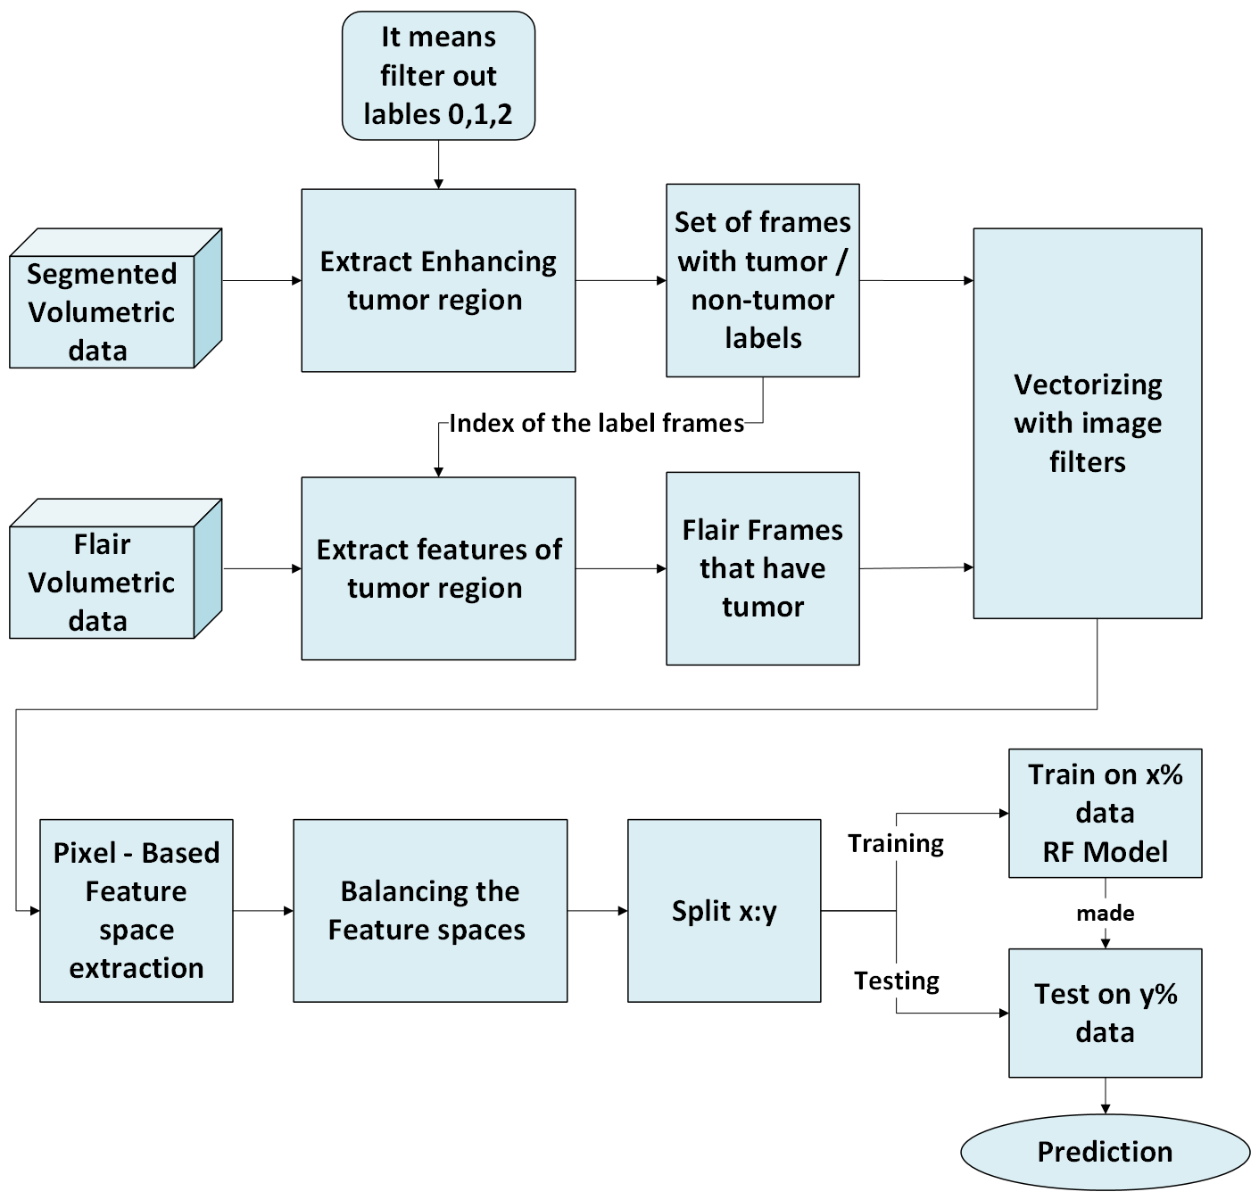
Methodology
Methodology section explains the outline of the key steps of our project, form data acquisition, preprocessing, Image processing techniques, Balancing dataset, evaluation, model development and extension to volumetric data.
We have illustrated our approach in figure.
Notes:
Methodology – Here we explains the key steps of our project.
data acquisition
preprocessing
Image processing techniques
Construction of feature space
Balancing dataset
evaluation
model development
extension to volumetric data.
The segmentation images of all the 20 volumetric data from the BraTS 2020 dataset were first processed and the enhancing tumor region was extracted by filtering out labels 0,1,2, leaving only the set of frames with tumor and non- tumor labels.
And from the indices of the 4th label tumor frames, features are extracted from the corresponding FLAIR images.
Then the Flair tumor frames are then vectorized initially with 8 image filters to extract features and are added later with the help of feature importance matrices to improve the feature extraction results.
Pixel based feature space was generated for each frame across all 20 volumetric datasets and was concatenated to create a comprehensive feature space for each volumetric data.
To solve the of class imbalance in the feature spaces, A balanced feature space was created by random sampling the majority class (non-tumor) to match the minority class (tumor), ensures that the models learn equally from both classes, improving the model's ability to detect tumors generalized on the balanced feature space.
A Random Forest classifier was trained on 80% of the first volumetric data that was split and tested on the remaining 20%, as well as across the feature spaces of the other datasets.

Slide 10
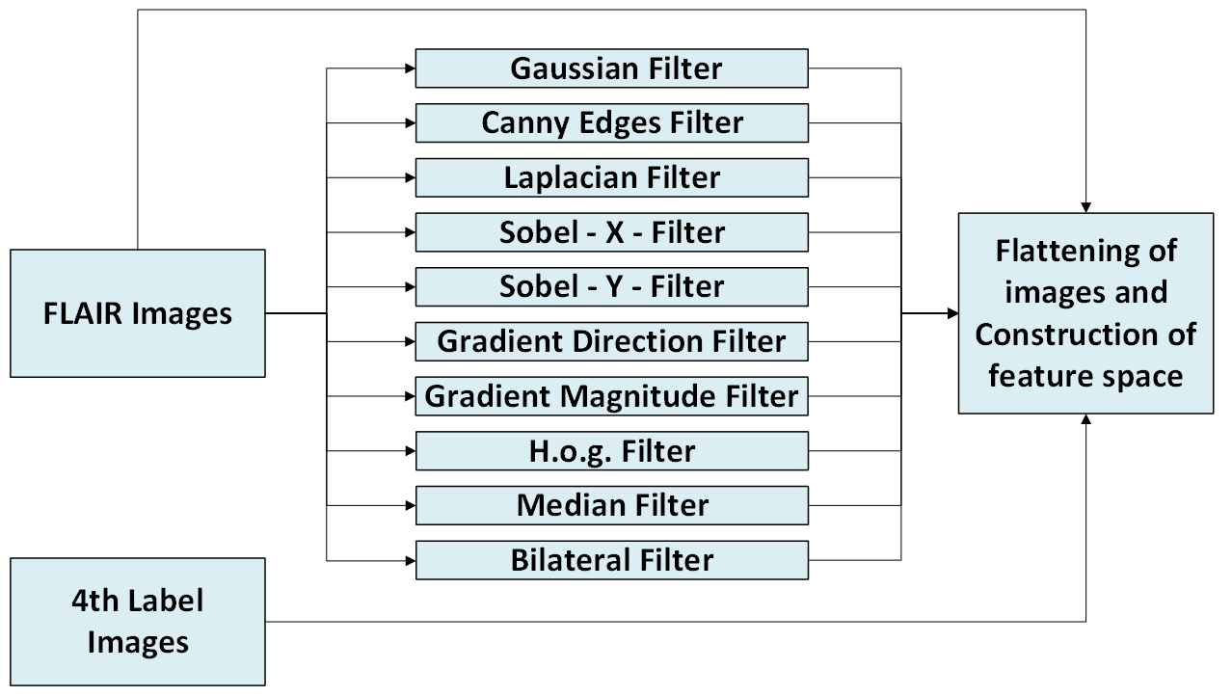
Methodology - Image Processing Filters
Notes:
Initially, we started by applying 8 filters to the flair images in order to extract specific features from images, such as edges, gradients, and textures.
The eight filters were: (go to next slide)
Gaussian blurring
Canny edge detection
Sobel x operator
Sobel y operator
Laplacian filtering
Histogram of Oriented Gradients (HOG)
Gradient magnitude
Gradient direction
Eventually we chose six more filters out of which we selected 2 with the help of feature importance matrices, which are Median filter and Bilateral filter, to enhance different aspects of the image, such as noise reduction, edge preservation, and texture enhancement.
The additional two filters expanded the range of features extracted from the images, to potentially improve the performance of the tumor detection algorithm by providing more robust and discriminative features for classification.

Slide 11
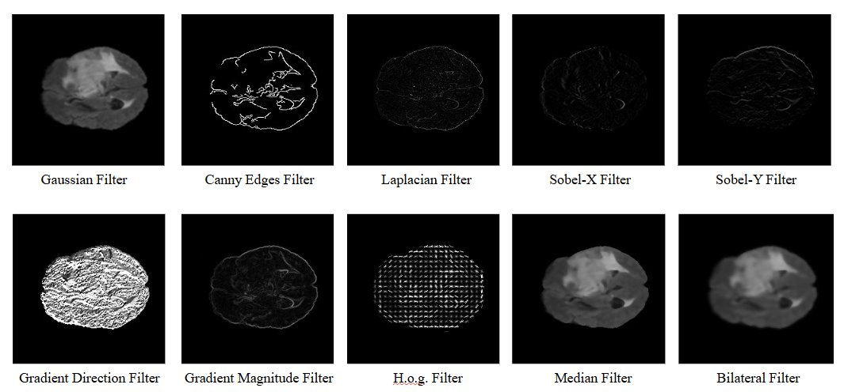
Methodology - Image Processing Filters
Notes:
Initial eight filters were:
Gaussian blurring
Canny edge detection
Sobel x operator
Sobel y operator
Laplacian filtering
Histogram of Oriented Gradients (HOG)
Gradient magnitude
Gradient direction
Additional two filters:
Median filter
Bilateral filter

Slide 12
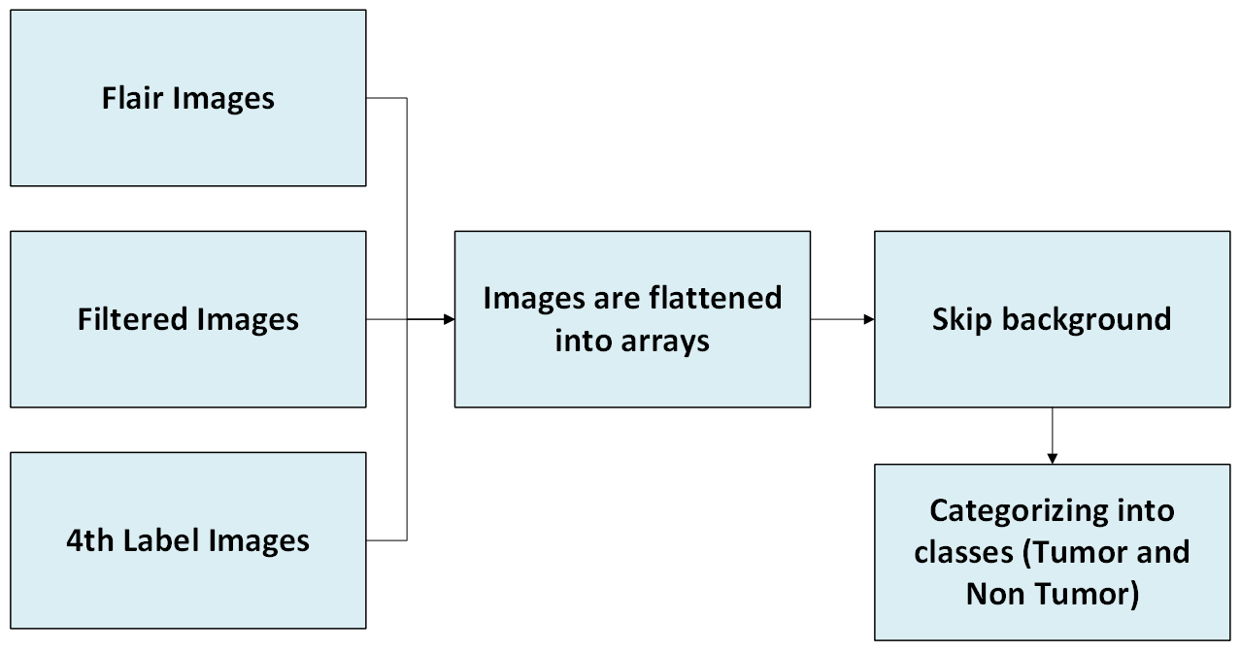
Methodology – Construction of feature Space
Notes:
To represent the extracted feature systematically we construct the feature space.
After the features are extracted, they are flattened and represented as arrays, where each element corresponds to a specific feature.
Each data point in the feature space corresponds to a region in the MRI scan, and the position of the point is determined by the values of the features extracted from that region.
The feature space construction started with ensuring that the flair image, filtered image and the label images all have the same dimensions.
For construction of feature spaces, both flair images and filtered images are taken and we then iterated through each pixel of the flair, filtered and label images, categorizing pixels based on their values.
Background pixels (where both flair and label values are 0) were skipped.
Pixels with nonzero value in flair image and zero values in label image were labeled as "no tumor".
While pixels with both nonzero values in both flair and label image were labeled as "tumor".
This feature space was constructed by storing the nonzero flair pixel values as f1 along with their corresponding labels and the features from f2 to f9 or f11 for 8 or 10 features respectively.
The feature space was organized into a structured dataframe for further analysis. The resulting dataframe is saved as a CSV file.
This process was followed on a loop to build a feature space for all frames across 20 volumetric data.\\

Slide 13
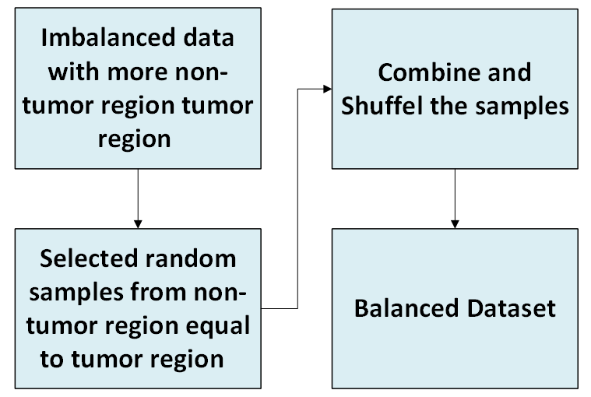
Methodology – Balancing Dataset
Notes:
To make sure that we have an equal representation of both tumor and non-tumor samples we balanced the dataset as an imbalance can lead to biased models that perform poorly on the minority class (tumor) while achieving high accuracy on the majority class (non-tumor).
The initial feature spaces that we generated and used for training the models were imbalanced, having fewer tumor samples compared to non-tumor samples.
This class imbalance led to the model having high accuracy but poor Precision and Recall for tumor detection.
This meant that the model accurately classified non-tumor samples, but found it hard to correctly identify tumor samples, which is critical for medical diagnoses.
To address this issue, we balanced the feature spaces through random sampling.
Which involved randomly under sampling the majority class (non-tumor) to match the number of samples in the minority class (tumor).
Created a more balanced dataset, which in turn ensures that the models learn from both tumor and non-tumor samples equally, improving their ability to generalize to new, unseen data.
This led to more accurate and reliable predictions for tumor detection.

Slide 14
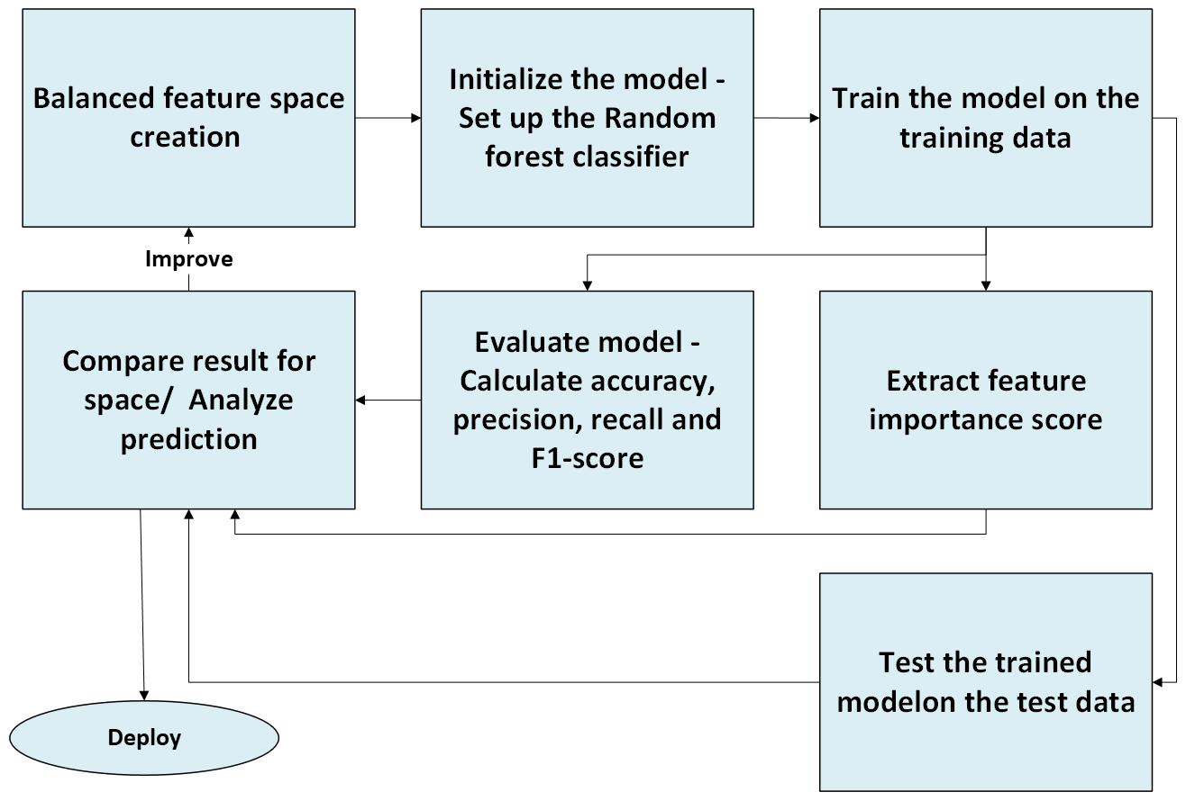
Methodology – Random Forest

Slide 15
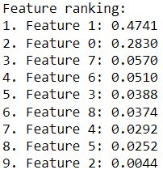
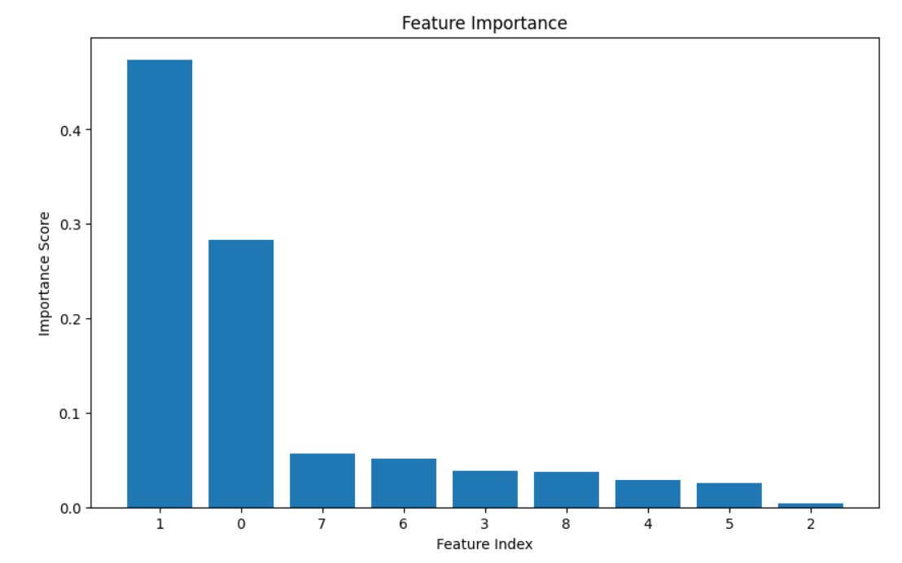
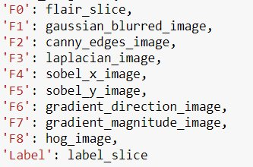
Feature Importance matrices for 8 feature

Slide 16
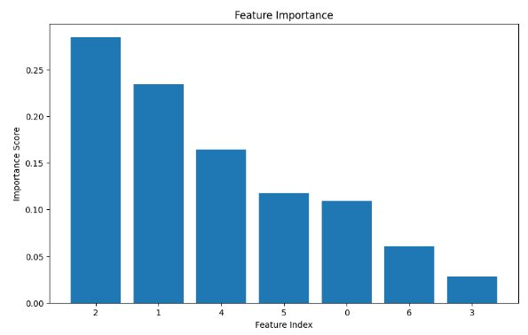
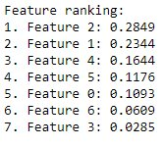
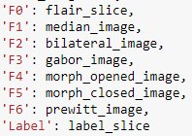
Feature Importance matrices for 6 feature
Notes:
Median Filter
Bilateral Filter
Gabor Filter
Morph opened filter
Morph closed filter
Prewitt Filter

Slide 17
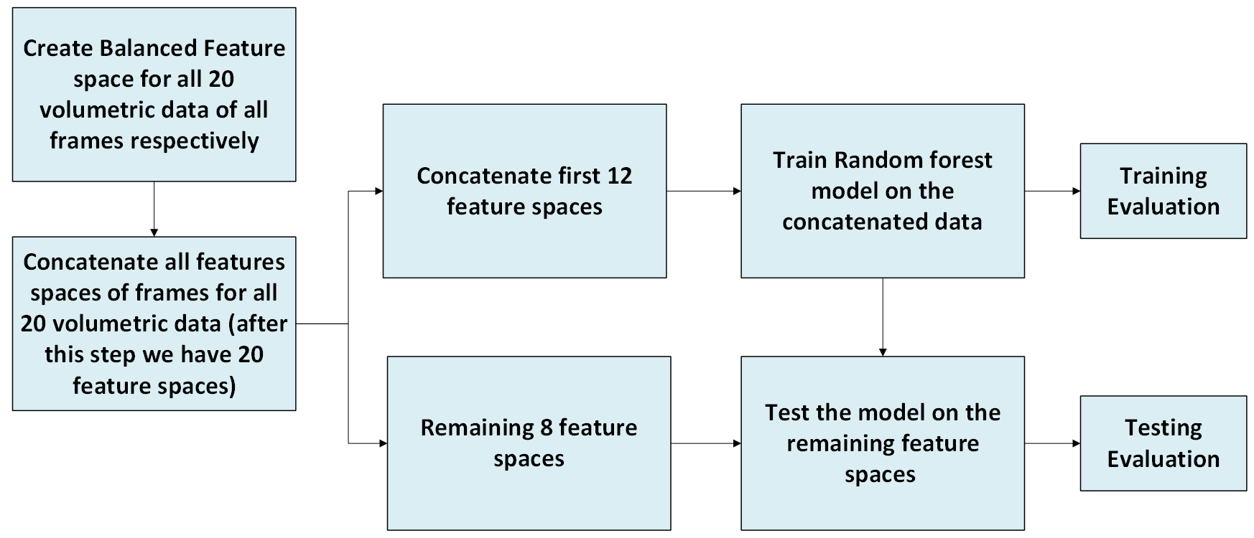
Experimental Section– Simulation 1 and 2

Slide 18
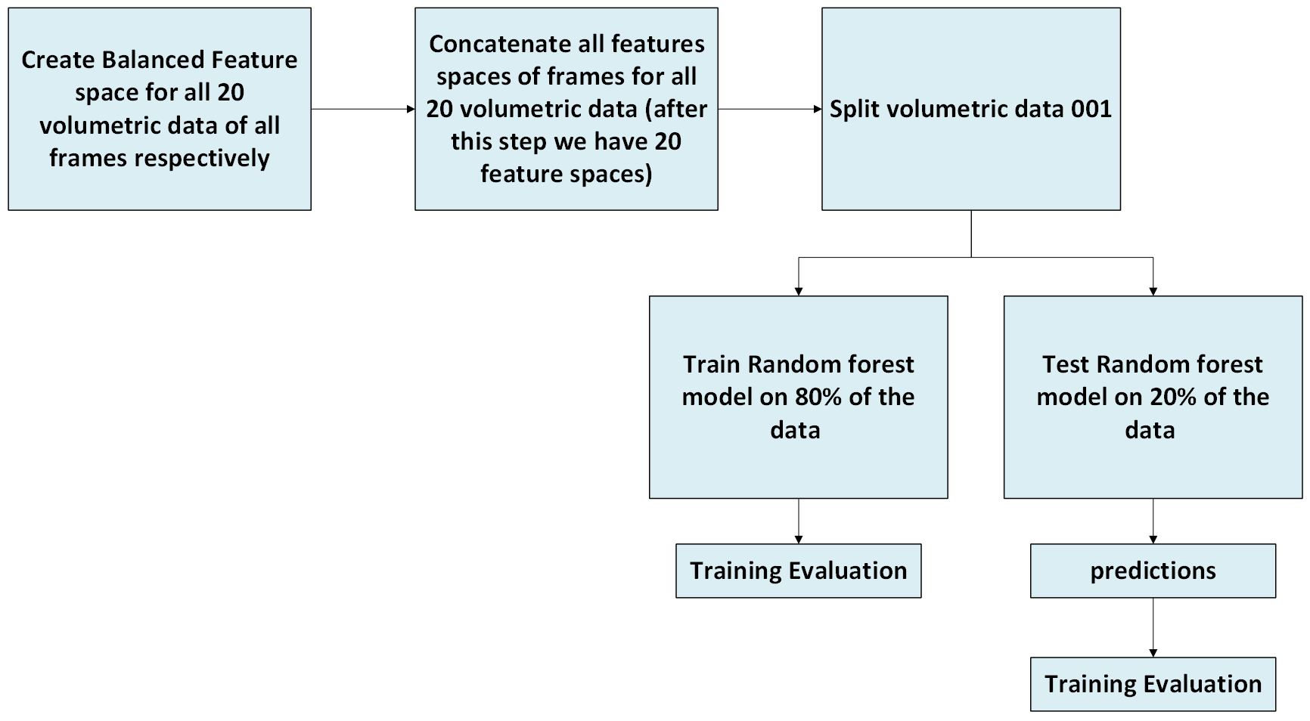
Experimental Section– Simulation 3

Slide 19
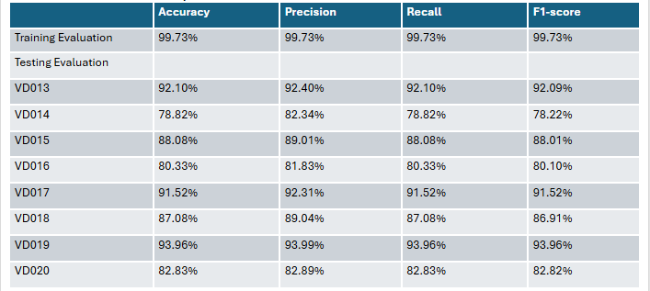
Results Section – Simulation 1

Slide 20
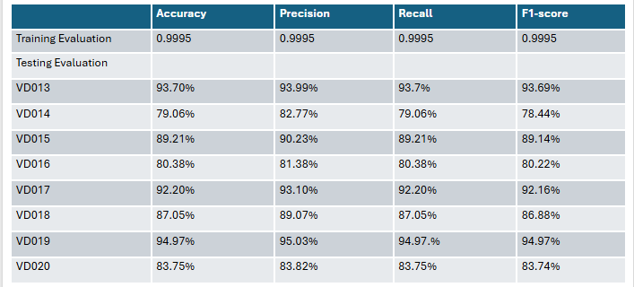
Results Section – Simulation 2

Slide 21
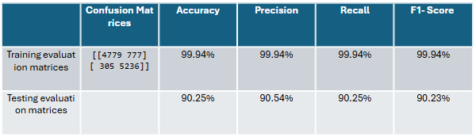
Results Section – Simulation 3 (Curiosity 1)

Slide 22
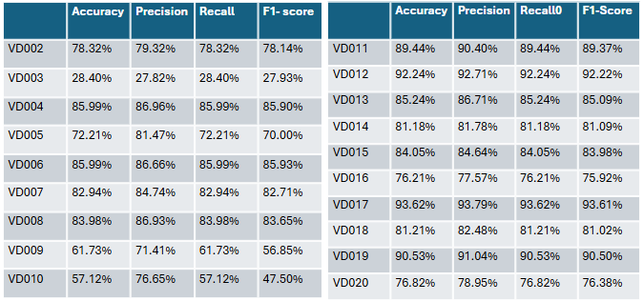
Results Section – Simulation 3 (Curiosity 1)

Slide 23
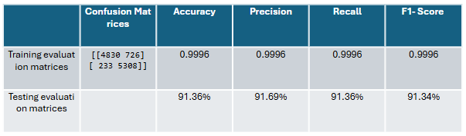
Results Section – Simulation 3 (Curiosity 2)

Slide 24
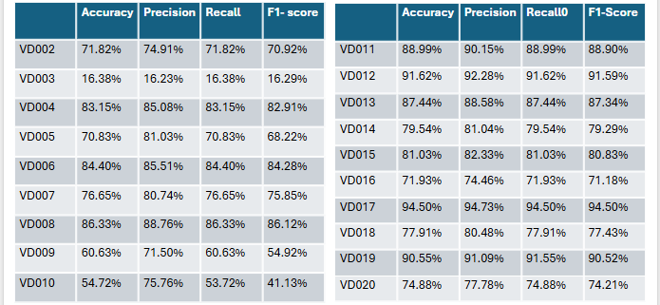
Results Section – Simulation 3 (Curiosity 2)

Slide 25
Observations
When comparing simulation 1 and 2 we observe that the results of simulation 2, is slightly better that simulation 1.
When creating simulation 2 randomly using 6 feature spaces the results were poorer compared to simulation 1
simulation 2 results were better when we added 2 top performing features to the original 8 in simulation 1
Conclusion
The model gives better results if we selectively chose the top performing features.
Notes:
Median Filter
Bilateral Filter
Gabor Filter
Morph opened filter
Morph closed filter
Prewitt Filter

Slide 26
Thank you Thank you Dr. Fu I wanted to express my sincere gratitude for taking the time to attend my master's project defense.

